Slide 1


Work Assignment
Master Informatics Engineering
Parallel and Distributed Computing
Advanced Architectures
Grupo 2
Gabriel Dias Fernandes - A71492
João Miguel Afonso - A71874
Universidade do Minho
Janeiro 2017

Slide 2
Hardware Characterization

Slide 3
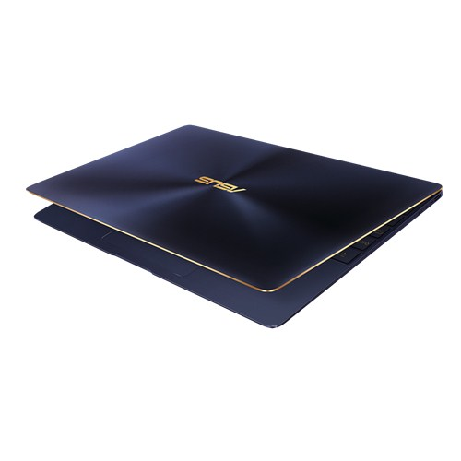
Team laptop
ASUS ZenBook 3 UX390UA
CPU:
Intel® Core™ i7-7500U Processor Dual-Core
Clock Frequency: 2.70 GHz
L3 Cache: 4 MB

Slide 4
Team laptop
Memory Hierarchy
32 KB
(per core)
L1
256 KB
(per core)
L2
4 MB
(shared)
L3
16 GB
RAM

Slide 5
Team laptop
CPU Dual-Core 2.70 GHz
Fused Multiply Addition
Single Instruction Multiple Data - 256 bits
HyperThreading and Pipelining
2.7 GHz x 2 cores x 2 FMA x 8 SP SIMD

Slide 6
86.4 GFlops
43.2 GFlops per core
Theoretical Peak Performance

Slide 7
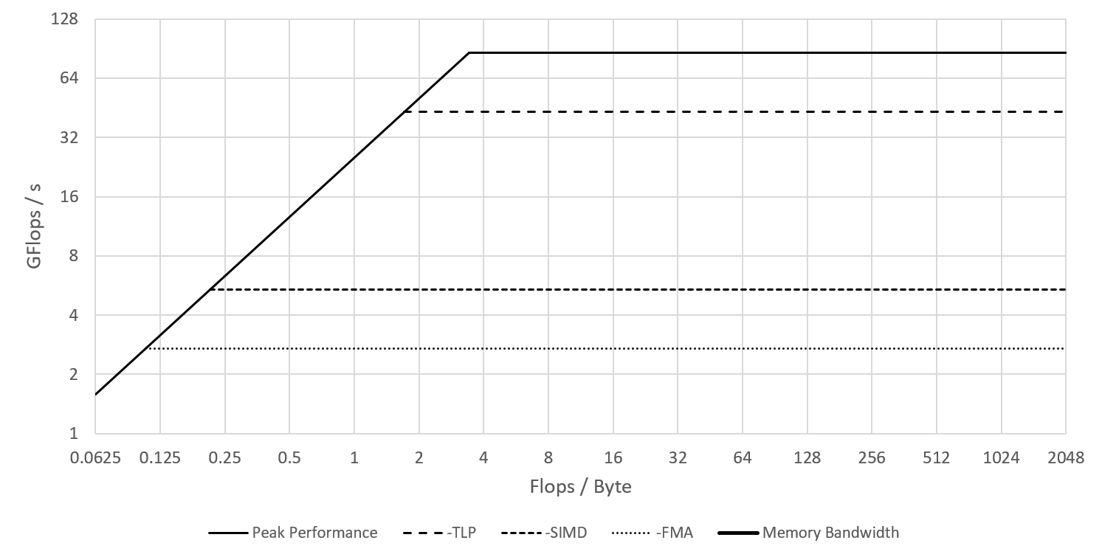
Roofline Model Laptop
Peak Performance
Without TLP
Memory Bandwidth
Without SIMD
Without FMA

Slide 8
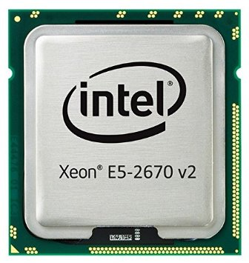
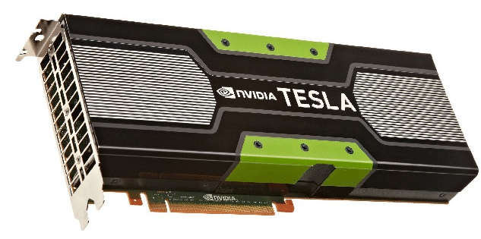
Cluster 652-node
CPU:
Intel® Xeon® Processor E5-2670 v2 Deca-Core
Clock Frequency: 2.50 GHz
L3 Cache: 25 MB
Device:
Number of processor cores: 2496
Processor core clock: 706 MHz

Slide 9
Cluster 652-node
Memory Hierarchy
32 KB
(per core)
L1
256 KB
(per core)
L2
25 MB
(shared)
L3
64 GB
RAM

Slide 10
Cluster 652-node
Dual CPU Deca-Core 2.50 GHz
Single Instruction Multiple Data - 256 bits
HyperThreading and Pipelining
2.5 GHz x 2 x 10 cores x 8 SP SIMD

Slide 11
400 GFlops
20 GFlops per core
Theoretical Peak Performance

Slide 12
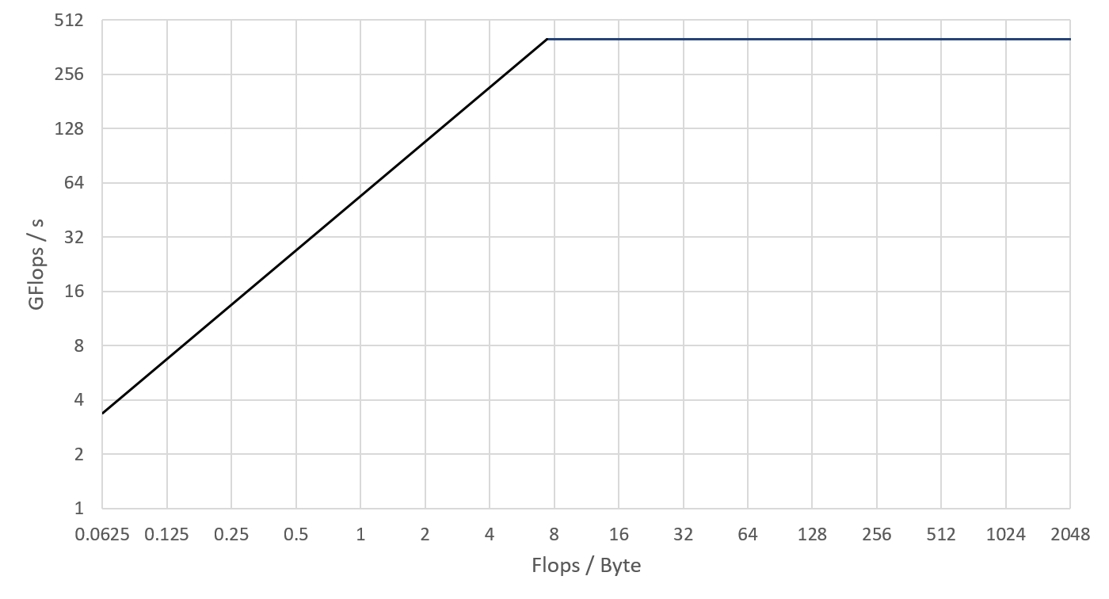
Roofline Model Cluster 652-node
Peak performance
Memory Bandwidth

Slide 13
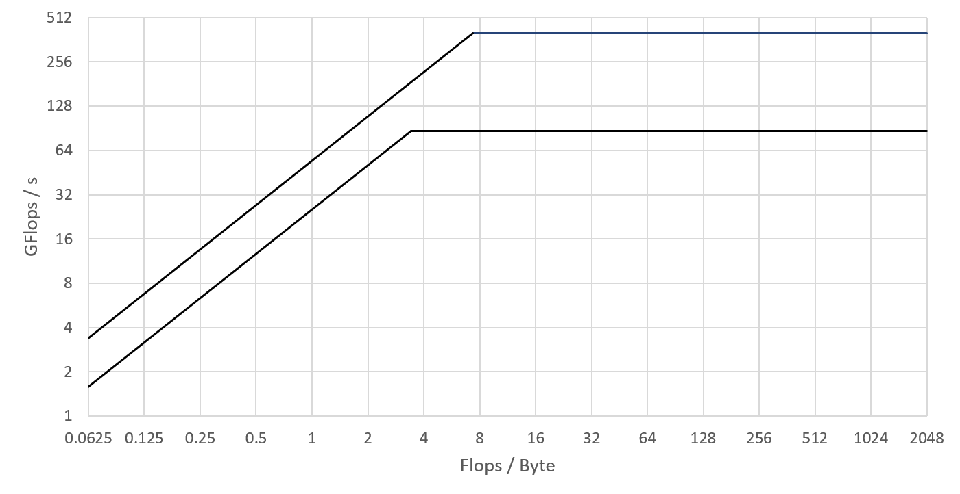
Roofline Model Comparison
Peak Performance Cluster node
Memory Bandwidth Cluster node
Peak Performance Laptop
Memory Bandwidth Laptop

Slide 14
Case study - Matrix dot product

Slide 15
Data sets
Fit 3 matrices in each memory level
Recommended: N should be a power of 2 (alignment)
Cache L1:
32 KB
8K Floats
2730 Floats per matrix (max)
52x52 matrix (max)
Cache L2:
256 KB
64K Floats
21845 Floats per matrix (max)
147x147 matrix (max)
Cache L3:
25 MB
6.25M Floats
~ 2.2M Floats per matrix (max)
1478x1478 matrix (max)

Slide 16
Data sets
Cache L1:
32 KB
N = 32
Cache L2:
256 KB
N = 128
Cache L3:
25 MB
N = 1024
RAM:
N = 2048

Slide 17
PAPI Usage
Chosen metrics
Time: gettimeofday (usec precision)
L1 miss-rate: PAPI_L2_DCR / PAPI_LD_INS
L2 miss-rate: PAPI_L3_DCR / PAPI_L2_DCR
L3 miss-rate: PAPI_L3_TCM / PAPI_L3_TCA ( Low accuracy! )

Slide 18
Performance analysis
Cache Behaviour for I-J-K matrices
 | L1 Miss rate (%) | L2 Miss rate (%) | L3 Miss rate (%)
32x32 | 0.758536 | 38.78111 | 58.4197
128x128 | 7.601346 | 0.984961 | 52.06356
1024x1024 | 8.23412 | 2.47862 | 2.785246
2048x2048 | 8.25904 | 2.499091 | 1.931329

Slide 19
Performance comparison
Time (milliseconds)
 | 32x32 | 128x128 | 1024x1024 | 2048x2048
I-J-K | 0.048 | 2.942 | 2761.795 | 21454.305
I-K-J | 0.032 | 2.687 | 1300.819 | 10376.311
J-K-I | 0.032 | 6.763 | 11406.119 | 93727.949
I-J-K (transpose) | 0.029 | 2.613 | 988.192 | 7918.431
J-K-I (transpose) | 0.033 | 2.623 | 1324.434 | 10809.109

Slide 20
Performance comparison
Time (milliseconds)
 | 32x32 | 128x128 | 1024x1024 | 2048x2048
I-J-K (transpose) | 0.034 | 2.613 | 988.192 | 7918.431
I-J-K (tiled) | 0.043 | 2.725 | 1155.475 | 9069.133
I-J-K (tiled w/ TLP) | 0.608 | 3.763 | 293.226 | 6820.012
I-J-K (CUDA) | 266.561 | 271.208 | 300.067 | 474.101
I-J-K (Tiled CUDA) | 268.462 | 270.861 | 281.840 | 359.777

Slide 21
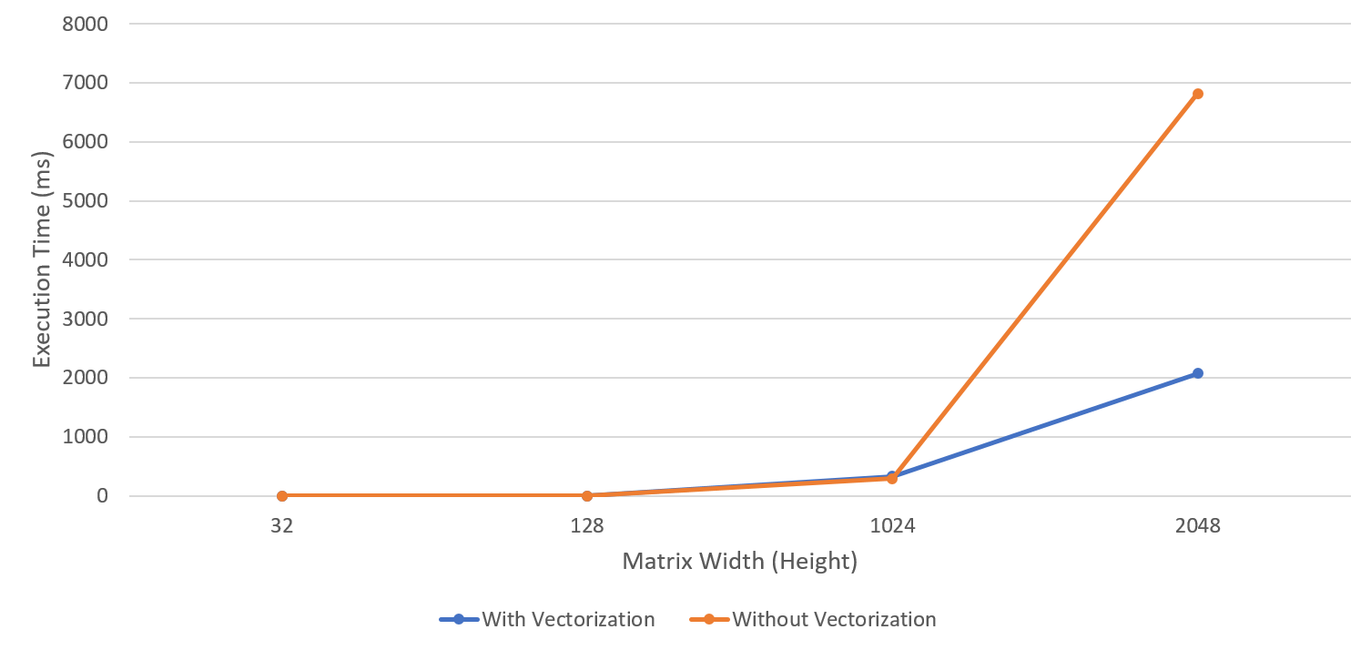
Vectorization (I-J-K block index-order)

Slide 22
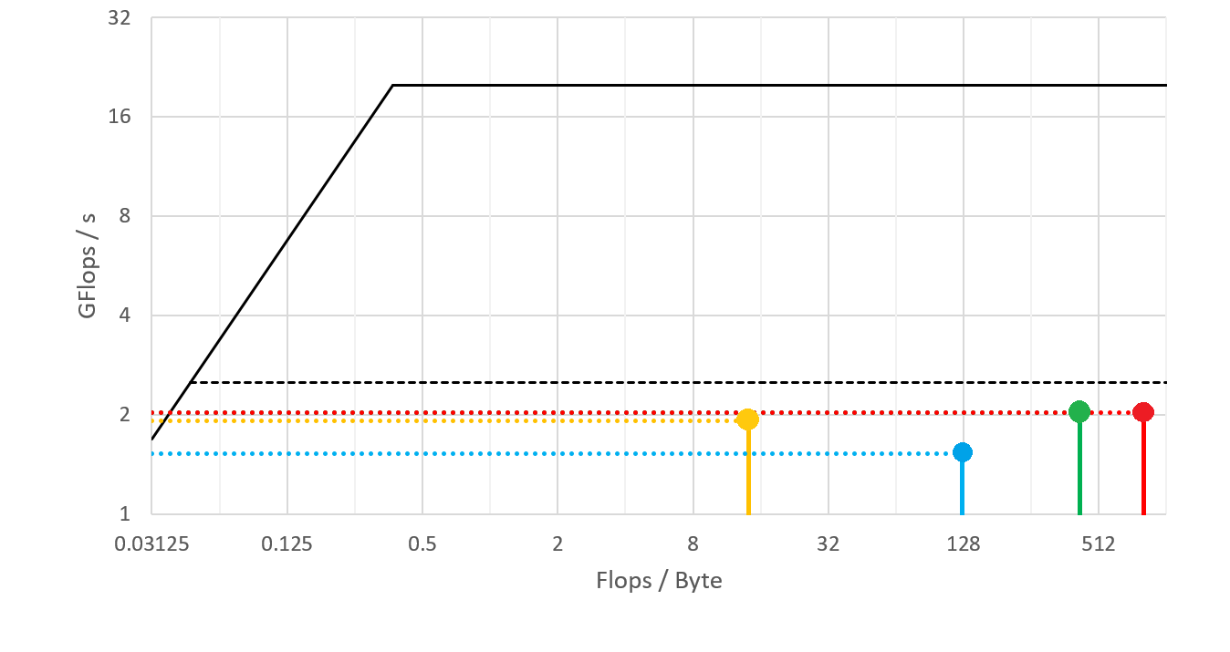
Roofline Measured - Performance Analysis
I-K-J Transpose

Slide 23
Work Assignment
Master Informatics Engineering
Parallel and Distributed Computing
Advanced Architectures
Grupo 2
Gabriel Dias Fernandes - A71492
João Miguel Afonso - A71874
Universidade do Minho
Janeiro 2017

